Slide 1
Universal open-image predictor
Group 11
Aadish Joshi | asj170430
Piyush Mahatkar | pkm170230

Slide 2
Idea & Inspiration
GoogleAI: Inclusive Images Challenge
The motto: To make products that work for people all over the globe. In the field of classification, this means developing models that work well for regions all over the world.
A system trained on a dataset that doesn’t represent a broad range of localities could perform worse on images drawn from geographic regions underrepresented in the training data.
For example.

Slide 3
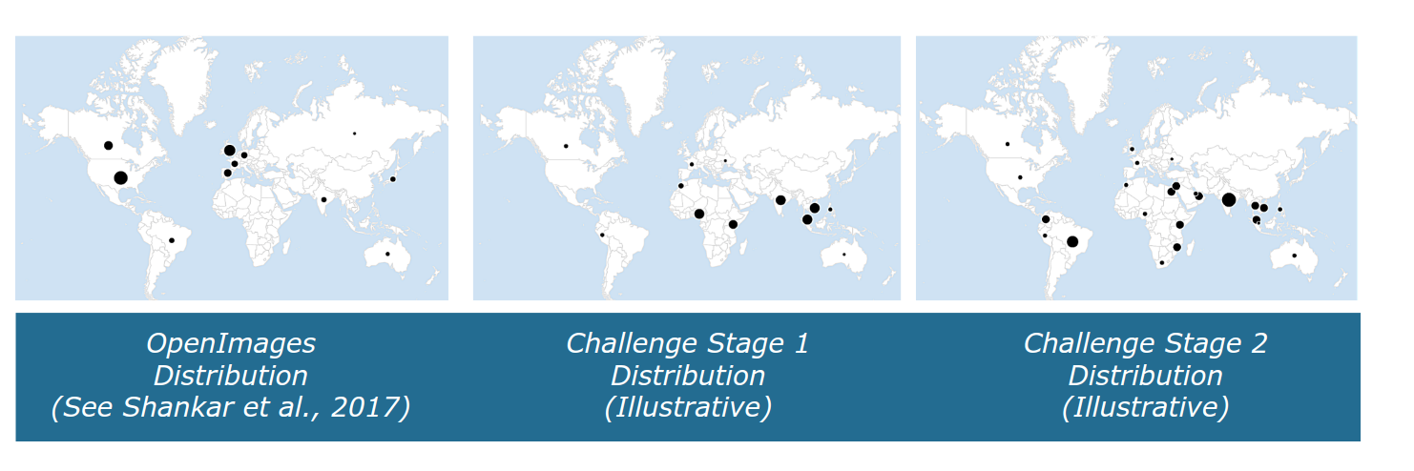
Data Generated Locations

Slide 4
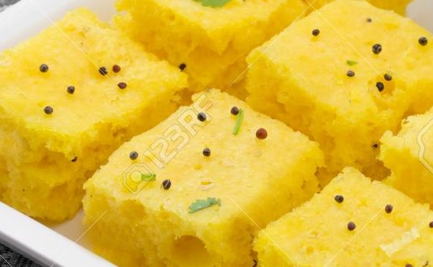
What is this?
Sponge ?

Slide 5
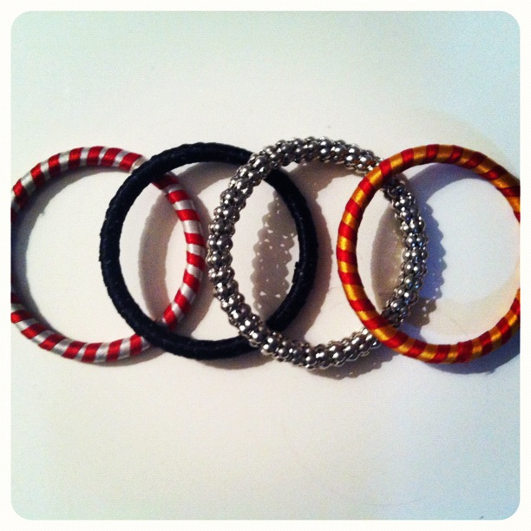
What is this?
Audi ?

Slide 6
Dataset
Data size: ~16GB.
# validation images: ~40K.
# test images: ~15K.
# label classes : 19998
# human label: 803K[Confidence 1]
# Machine labels : 15M [Confidence 0]

Slide 7
Starting point
We knew that images would come from diverse regions. We used
Data augmentation and ensembling.
https://arxiv.org/pdf/1506.07224.pdf
Some approaches for diversity:
1) Different CNN architectures
2) Different Image sizes
3) Train with/without augmentation
4) Different augmentation schedules

Slide 8
Hardware Utilized
Processor: Intel(R) Core(TM) i5-5200U CPU @ 2.20GHz, 2195 Mhz, 2 Core(s), 4 Logical Processor(s)
GPU: 2x NVIDIA GEFORCE 1080
RAM: 8 GB
HDD: 1x 1TB
In memory: 8GB

Slide 9
Failed / Over Time Experiments
ResNet50, 60epochs, 224X224, adam optimizer 0.001, batch 64, increasing augmentation schedule
~ 4+ hours / epoch
InceptionV3, 30epochs, 400X400, adam optimizer 0.001, batch 32, increasing augmentation schedule
~ 4+ hours /epoch
So we COMPROMIZED.

Slide 10
Dataset under consideration
Data size: ~16GB.
# validation images: ~10K.
# test images: ~1K.
# label classes : 20
# human label: 551K [Confidence 1]
# Machine labels : 512K [Confidence 0]

Slide 11
Data Augmentations used
A very useful library: albumentations
Horizontal flip
One of the noises: Additive Gaussian Noise / Gauss Noise
One of Motion Blur / Median Blur
Shift scale rotate
One of Optical Distortion, Grid distortion, Piecewise Affine
One of CLAHE / Sharpen / Emboss / Random Contrast / Brightness
HueSaturation
Gray scale
Jpeg Compression

Slide 12
Data Ensemble
We trained data separately on
InceptionV3
ResNet50
InceptionResnet V2.
Our Module
Weighted Avg of prediction.

Slide 13
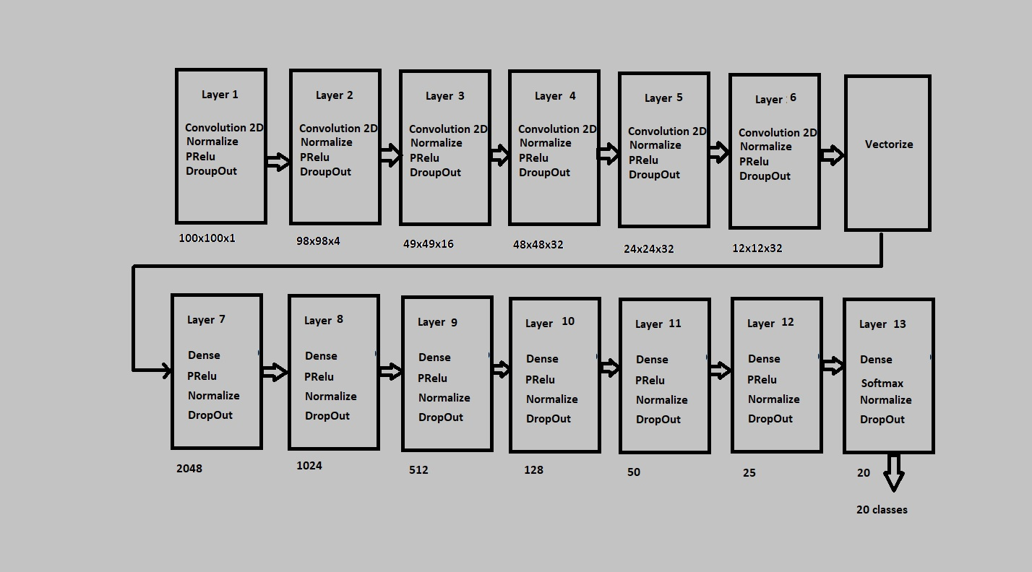
Model for 20 classes

Slide 14
Training process
Train/test split : 9:1 [9K : 1K]
Epochs: 10
Entropy loss: categorical_crossentropy.
Optimizer: RMSProps lr 0.001

Slide 15
References
albumentations
https://github.com/albu/albumentations
Squeeze-and-Excitation Networks
https://arxiv.org/pdf/1709.01507.pdf
Deep CNN Ensemble with Data Augmentation for Object Detection
https://arxiv.org/pdf/1506.07224.pdf
DEEP NEURAL NETWORKS UNDER STRESS
https://arxiv.org/pdf/1605.03498.pdf

